Slide 1
Friend Blend
Team APPY FIZZ
Ahish Deshpande
Pranav Kirsur
Pranav Tadimeti
Yoogottam Khandelwal

Slide 2
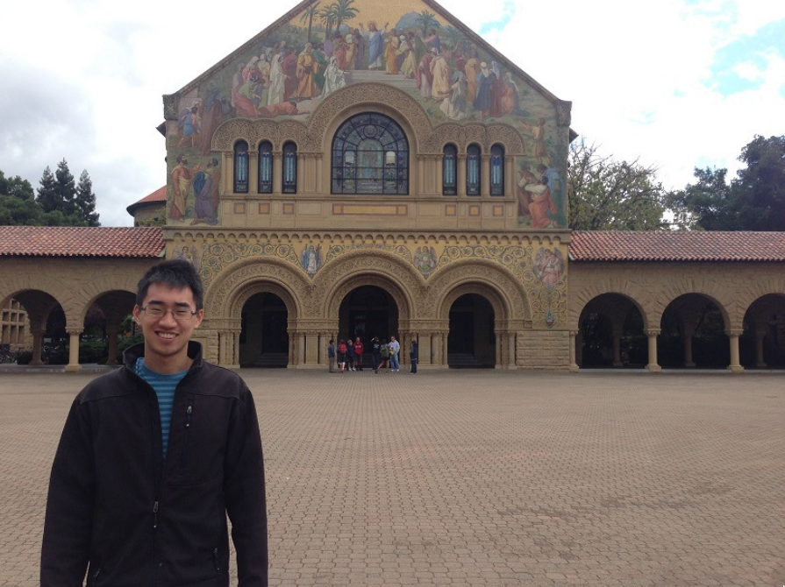
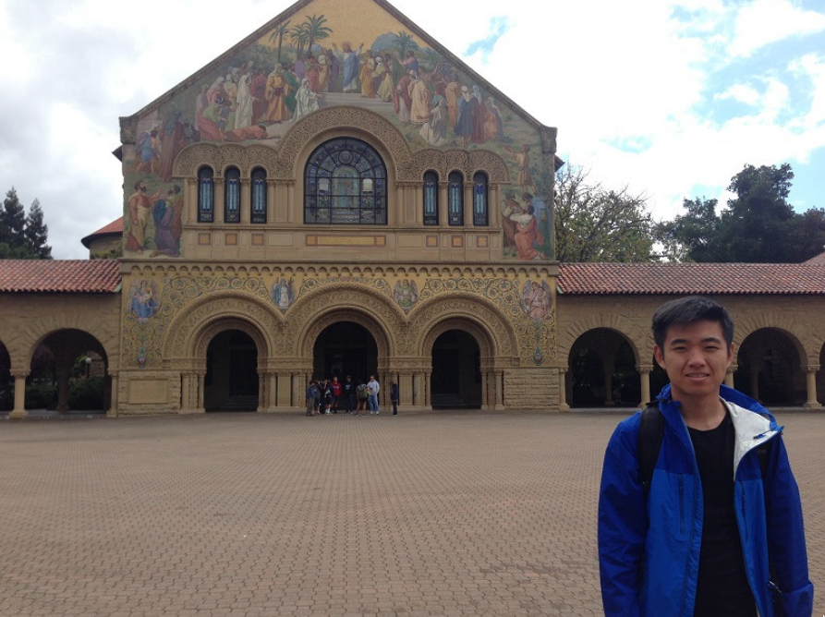
Problem Description
Two friends don’t want to take a selfie, maybe because of camera resolution.
Want to have a picture together, nobody around to take it.
Two people visit the same place at different times but want to have a picture together at that place.
Notes:
Two friends put same teams/zoom background but want a picture together

Slide 3
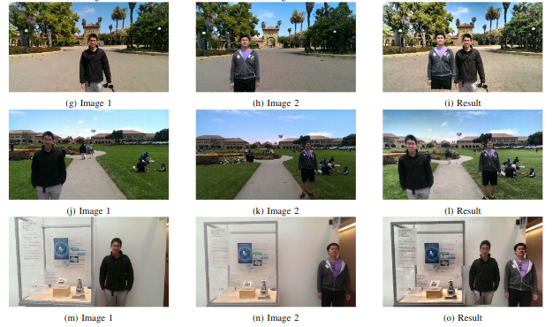
Project Paper Introduction
Given two input images, our goal is to create a third image with both Person A and Person B in the photo together.
The FriendBlend algorithm mainly relies on segmentation and registration techniques for extraction and merging images.
Notes:
The authors of the paper made an assumption that there would be only one face in the input to get a reasonable output.
Provided assumptions are met, and implementation is correct, the results of the method described are quite convincing.
While more reliable techniques than the ones used in FriendBlend exist, they often sacrifice computational efficiency. Given the use of the algorithm in a mobile application, it is justified to use these less reliable techniques.

Slide 4
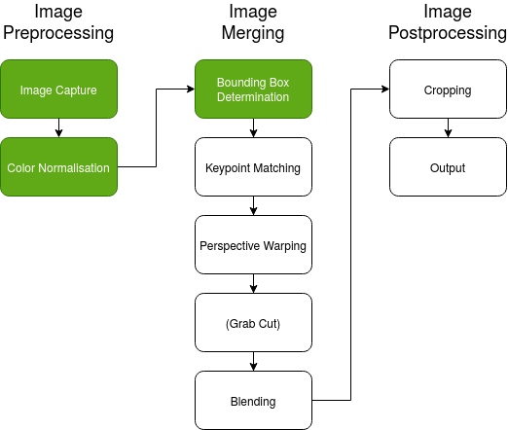
Process
Color correction
Face and body detection
Homography estimation
Keypoint Detection
Keypoint Matching
Homography Computation
Image blending
Notes:
1. Color Correction
In this step, we try our best to match the lighting and contrast of the two images so that once the images are blended, they look uniform. Contrast limited histogram equalization is used to facilitate this process.
2. Face and body detection
To perform the detection, we use the Haar Cascade Classifier which gives us the coordinates of the face in the image. We then use the formulas mentioned in the paper, to calculate the bounding box for the body.
3. Homography estimation
In this step, we estimate the relative transform between the common points of one image to the other. This is done by first finding the correspondences between the two images, and then using that data to find the best transformation from one image to the other. This is popularly known as homography.
Keypoint Detection
For keypoint detection, we will be using the ORB (Oriented FAST and Rotated BRIEF) algorithm.
Keypoint Matching
Keypoints in the two images are matched by Hamming distance which is recommended for ORB descriptors. A pair of keypoints, one from each image, are said to be matched if the keypoints are within a certain threshold hamming distance from each other.
Homography Computation
Once we have found a good set of matching keypoints in the two images, we can use the RANSAC algorithm to find the homography that best warps the images into the same perspective.
4. Image blending
Subjects are Far Apart
When the subjects are far apart, we use alpha blending to merge the two images.
Subjects are Close Together
GrabCut is used to merge the two images in this case

Slide 5
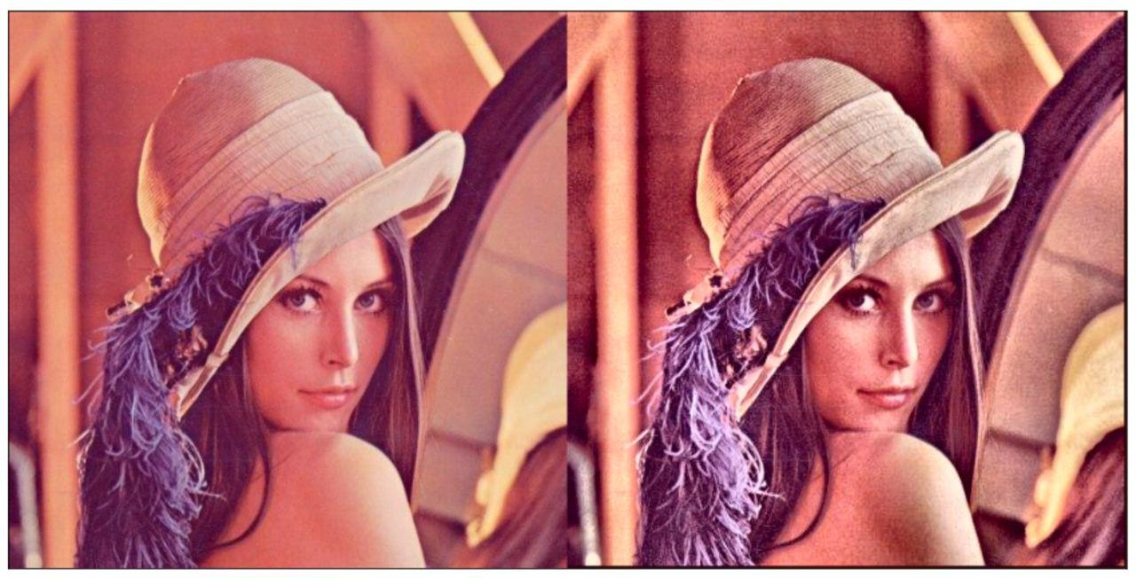
Stage 1 - Color Correction
It is crucial to make sure that the lighting from the two input images are approximately the same before the blending process to make the image look realistic.
Notes:
CLAHE Implementation
The above written apply_clahe() function takes in 4 inputs:
* The input image in BGR format
* The clip limit for contrast limiting
* Number of bins to divide the image into
* Grid size to be used while performing adaptive histogram equalization
The clahe() function performs the following 4 step process to perform color correction:
* Divides the image into frames/cells using the grid values passed to the function
* Creates a separate histogram for each cell/frame after binning the values based on the value passed to the function
* The histogram equalization mapping for each cell/frame is also generated
* Next, the contrast of the image is limited by clipping bin values if they are above a 'clip limit'
* Finally, adaptive histogram equalization is performed by interpolating the value for each frame by using neighboring frames

Slide 6

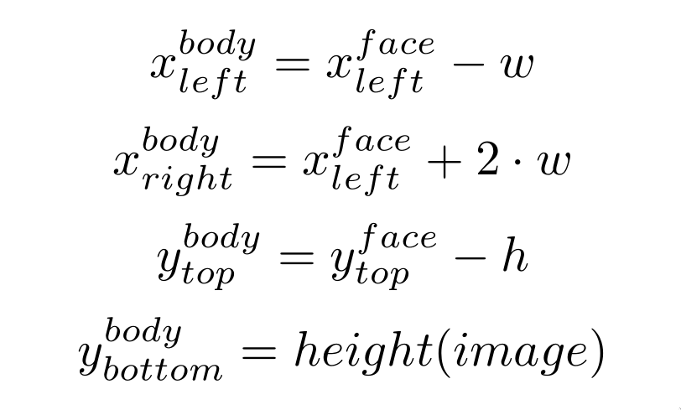
Stage 2 - Face and Body Detection
Notes:
Haar Cascade classifier is an effective object detection approach which was proposed by Paul Viola and Michael Jones in their paper, “Rapid Object Detection using a Boosted Cascade of Simple Features” in 2001.
https://docs.opencv.org/4.5.0/d1/de5/classcv_1_1CascadeClassifier.html#aaf8181cb63968136476ec4204ffca498
Computer Vision — Detecting objects using Haar Cascade Classifier
This is a cascading algorithm - this works by running some filter over the whole image after dividing it into patches.
We read the model weights from an xml file (they have multiple weight files for detecting various features like face, eyes, body, etc)
We run the model on that patch of image
If we get >= `minNeighbors` number of matches, that patch is classified as a face
This algorithm is run multiple times after scaling the image by some factor.

Slide 7
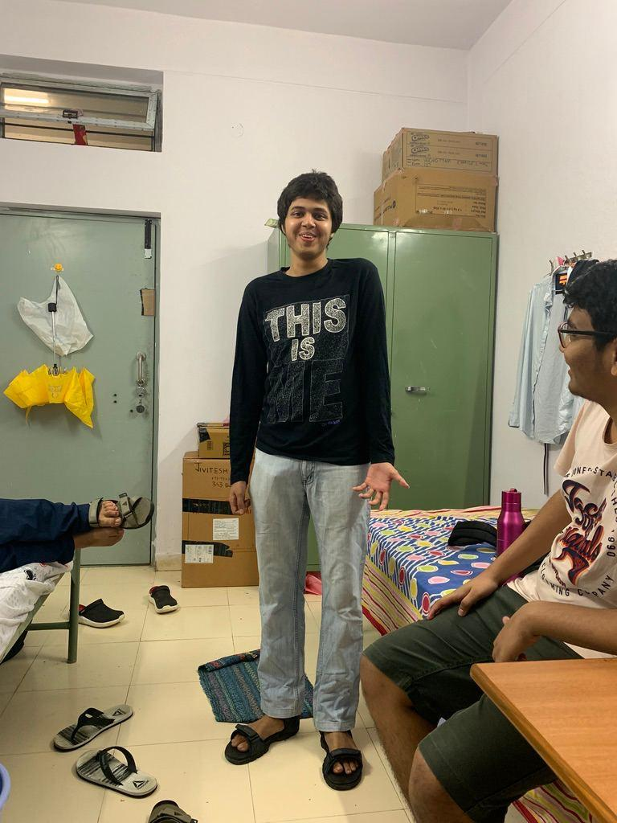
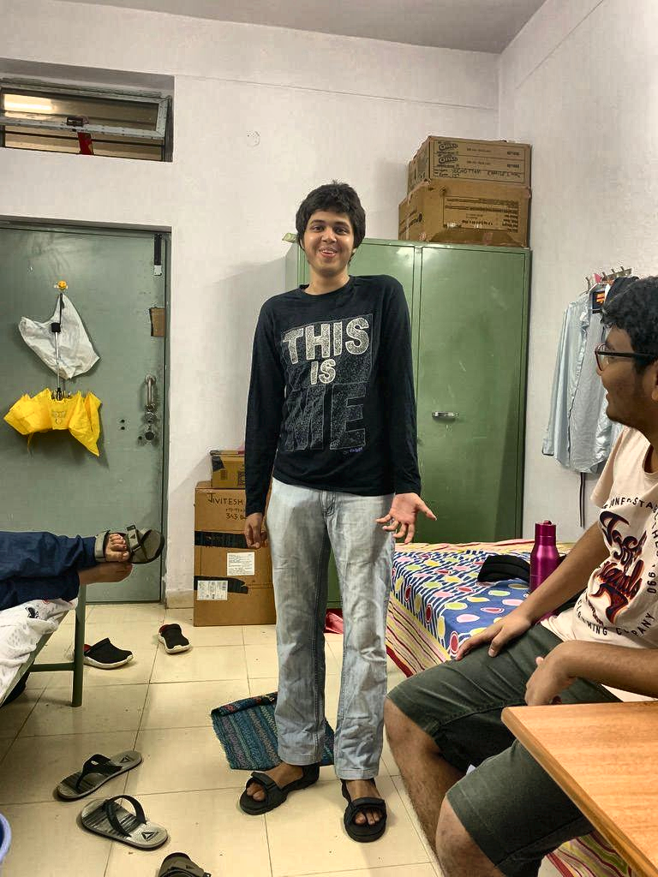
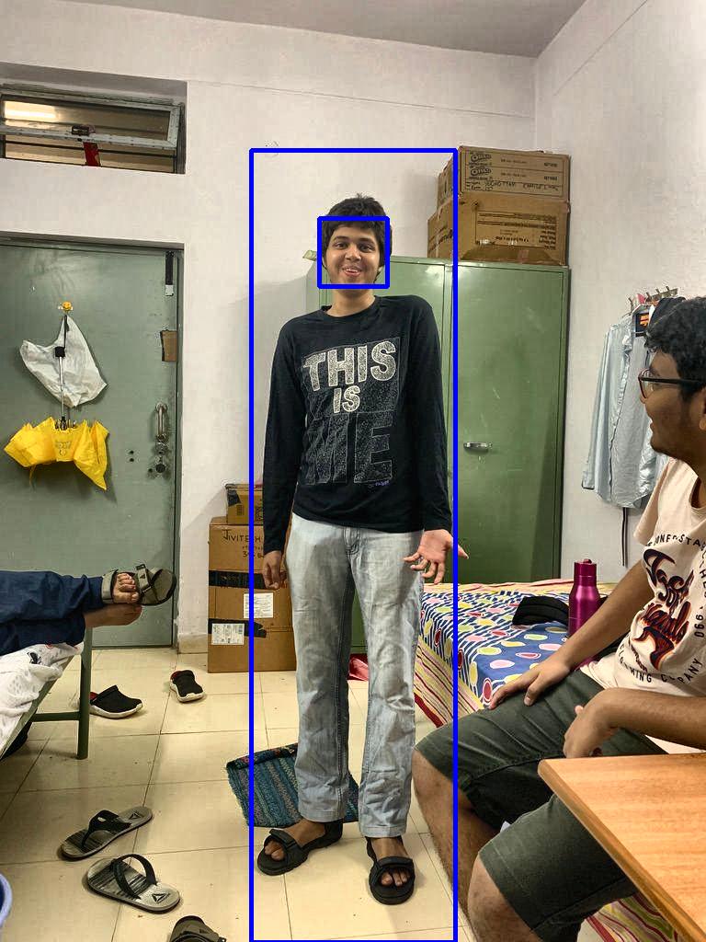
Current Progress
Input Image
Color Corrected Image
Predicted Bounding Box
Notes:
Input, Color-corrected, Face and body bounding boxes

Slide 8
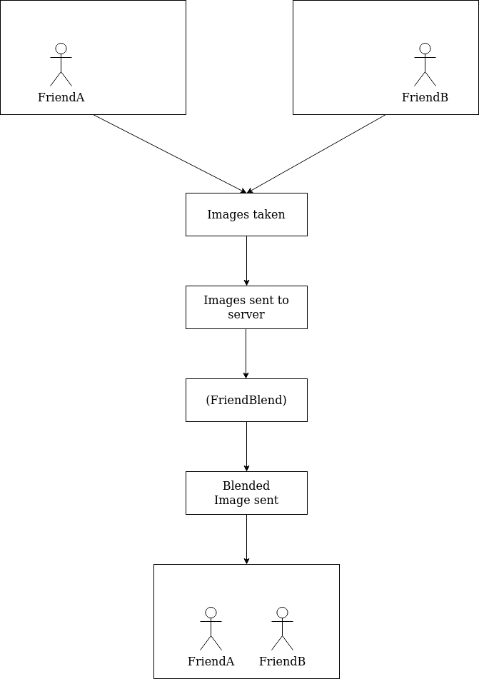
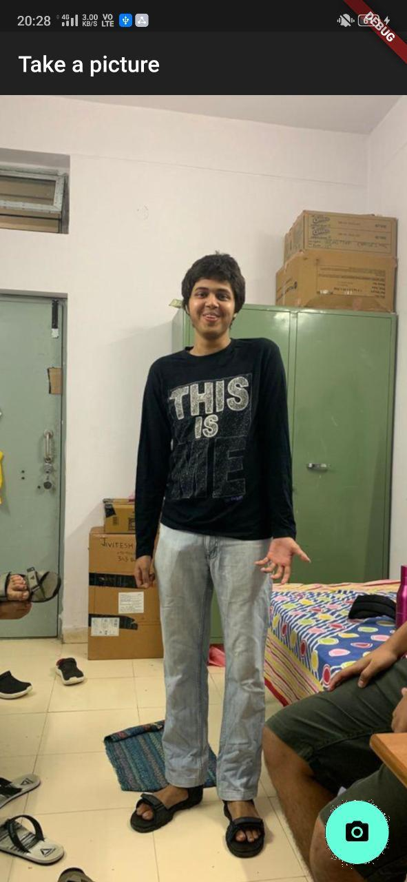
Mobile App
Since virtually everyone takes pictures with their phones, a mobile app is the best way to showcase the algorithm.
Notes:
We used flutter to make the mobile app so that it works on both Android and iOS.
The app will send 2 images to a server where our algorithm will run and send the blended image back.

Slide 9
Work left
Homography estimation:
Keypoint Detection
Keypoint Matching
Homography Computation
Image blending
We are on track according to the timeline and are confident that we’ll be able to finish the project in time.

Slide 10
Thank You
- Team APPY FIZZ

